Slide 1
Anomalies Detection on Pharma Data
A PoC based on Machine Learning and Spark
Ángel J. Rey

Slide 2
Anomaly Detection
Problem:
Try to find “anomalous records” for a data set
In supervised learning we would have a entries labeled as “normal” of “anomaly” but in the pharma fact data used as dataset for the PoC it is not the case
So unsupervised learning techniques will be used (clustering). They can learn how a regular datum is and detect when a new one is different and need further investigation
Clustering try to find natural groupings in data: Similar records in a dataset will be grouped in the same cluster

Slide 3
Anomaly Detection
K-Means Clustering:
ML classic unsupervised algorithm. It attempts to set K clusters for the provided data. https://en.wikipedia.org/wiki/K-means_clustering
K is the main hyper parameter of the model.
It depends of the dataset
To choose the right K value is crucial to have a good model
Different methods: Elbow, Average Silhouette, Gap statistic, low entropy…
To decide that a point (a record of the dataset) belongs to a particular cluster the concept of distance is needed
Different distances types can be applied: Euclidian, Minkowski, Manhattan…
Other Algorithms (out of the scope) instead K-Means can be used: Gaussian mixture, DBSCAN

Slide 4
Anomaly Detection
About used Dataset:
Fact table dataset for Pharmacies with Transactions.
Already clean with no categorical values.
Plain text, csv formatted, comma separated.
Features:
wk_id: Transaction week
trans_dt: Date of Transaction
fcc_cd: Product code
shop_cd: shop / pharmacy id
trans_typ_nbr: Type of transaction like sellin or sellout
trans_qty: Transaction quantity (amount of medicine sold)
trans_amt: Total Transaction amount

Slide 5
Anomaly Detection
How to detect anomalies:
K-means can be used to detect anomalous transactions.
K-means can cluster transactions based on statistics about each of them.
The resulting clusters themselves aren’t interesting per se, but they collectively define types of transactions that are like past transactions.
Any transaction not close to a cluster could be anomalous. Clusters are interesting because they define regions of normal transactions; everything else outside is unusual and potentially anomalous.
Outside it will be defined as all the distances between a transaction and the centroid of the cluster where the transaction has been assigned, that exceed a user-defined threshold

Slide 6
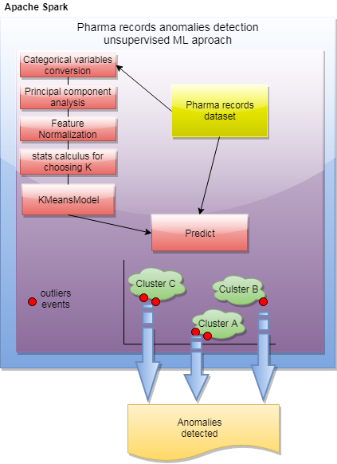
Anomaly Detection
High Level Diagram

Slide 7
Anomaly Detection
Technologies used:
Scala 2.12.: High-level, Object-oriented and functional language on top of JVM.
Apache Spark 2.4.: In memory general-purpose distributed computer system built with Scala. It runs in Mesos, YARN, Kubernetes or Standalone mode.
Spark MLlib 2.4: Apache Spark’s scalable machine learning library.

Slide 8
Anomaly Detection
Data preparation:
Common stuff to all the Spark Applications.
Get the Spark session: SparkSession.builder()
Load dataset: spark.read …
Create Spark DataFrame (a Dataset organized into named columns): toDF (…)
Cache the data: data.cache()
First look to the dataset:
Real dataset do not have a label.
A label column has been added for testing purposes.
All the records have been labeled as good Records (1).
Synthetic records have been introduced with anomalous values and labeled as bad Records (0) for testing purposes.
+-----+-----+
|label|count|
+-----+-----+
| 1|99999|
| 0| 10|
+-----+-----+

Slide 9
Anomaly Detection
Understanding MLLib Pipelines (1/4):
Common sequence of algorithms to process and learn from data standardized using high-level APIs on top of DataFrames
Pipelines are done with Pipeline stages that can be Transformers and Estimator:
Transformer: Is an algorithm which can transform one DataFrame into another DataFrame. E.g., an ML model is a Transformer which transforms a DataFrame with features into a DataFrame with predictions.
Estimator: Is an algorithm which can be fit on a DataFrame to produce a Transformer. E.g., a learning algorithm is an Estimator which trains on a DataFrame and produces a model.
Transformer VectorAssembler():
val assembler = new VectorAssembler().
setInputCols(inputCol). //inputCol all fields except label one
setOutputCol("featureVector")
If transform method is applied (just for visualization)
+------+--------+------+-------+-------------+---------+---------+-----+------------------------------------------------------+
|wk_id |trans_dt|fcc_cd|shop_cd|trans_typ_nbr|trans_qty|trans_amt|label|featureVector |
+------+--------+------+-------+-------------+---------+---------+-----+------------------------------------------------------+
|201701|20170103|453606|2330 |91 |4 |49.44 |1 |[201701.0,2.0170103E7,453606.0,2330.0,91.0,4.0,49.44] |

Slide 10
Anomaly Detection
Understanding MLLib Pipelines (2/4):
Estimator Kmeans():
val kmeans = new KMeans().
setSeed(Random.nextLong()).
setPredictionCol("cluster").
setFeaturesCol("featureVector")
/*
- setDefault(k->2, maxIter->20, initMode->MLlibKMeans.K_MEANS_PARALLEL, initSteps->2, tol->1e-4, distanceMeasure->DistanceMeasure.EUCLIDEAN)
- Related to setSeed:
- The Random Partition method (chosen) first randomly assigns a cluster to each observation and then proceeds to the update step, thus
computing the initial mean to be the centroid of the cluster's randomly assigned points.
- The Forgy method tends to spread the initial means out, while Random Partition places all of them close to the center of the data set
- Input Columns:
Param name Type(s) Default Description
featuresCol Vector "features" Feature vector
- Output Columns:
Param name Type(s) Default Description
predictionCol Int "prediction" Predicted cluster center
*/

Slide 11
Anomaly Detection
Understanding MLLib Pipelines (3/4):
Creating a Pipeline:
assembler is a transformer (it contains a transform method)
kmeans is an estimator (it contains a fit method, which accepts a DataFrame and produces a Model, which is a transformer)
fit method to obtain kmeans model is not used directly but throw the pipeline:
val pipeline = new Pipeline().setStages(Array(assembler, kmeans))
// pipeline fit internally is going to call to transform in assembler and to fit in kmeans
val pipelineModel = pipeline.fit(data) //pipeline itself it is an estimator the will produce a model
val kmeansModel = pipelineModel.stages.last.asInstanceOf[KMeansModel]
// ^ both pipelineModel and kmeansModel are transformers
Printing the default k=2 cluster centers:
kmeansModel.clusterCenters.foreach(println)
CLUSTER CENTERS:
[201701.00000000003,2.016948600745999E7,698147.6944033653,5332.661934338954,45.224128298662464,3.2080088073876896,91.22536067567904]
[201701.0,2.0169380238384716E7,252506.77512707212,5293.452810911599,44.55342136854742,3.293479093765166,36.75581773134572]

Slide 12
Anomaly Detection
Understanding MLLib Pipelines (4/4):
Making predictions:
val withCluster = pipelineModel.transform(data) //withCluster is a dataframe
withCluster.show (25, truncate = false) /*
PREDICTIONS:
+------+--------+------+-------+-------------+---------+---------+-----+-------------------------------------------------------+-------+
|wk_id |trans_dt|fcc_cd|shop_cd|trans_typ_nbr|trans_qty|trans_amt|label|featureVector |cluster|
+------+--------+------+-------+-------------+---------+---------+-----+-------------------------------------------------------+-------+
|201701|20170103|453606|2330 |91 |4 |49.44 |1 |[201701.0,2.0170103E7,453606.0,2330.0,91.0,4.0,49.44] |1 |
|201701|20170105|11443 |5072 |32 |18 |135.9 |1 |[201701.0,2.0170105E7,11443.0,5072.0,32.0,18.0,135.9] |1 |
|201701|20170104|313961|4169 |31 |2 |22.5 |1 |[201701.0,2.0170104E7,313961.0,4169.0,31.0,2.0,22.5] |1 |
|201701|20170105|7631 |5984 |31 |2 |13.0 |1 |[201701.0,2.0170105E7,7631.0,5984.0,31.0,2.0,13.0] |1 |
|201701|20170104|742041|11034 |31 |2 |16.38 |1 |[201701.0,2.0170104E7,742041.0,11034.0,31.0,2.0,16.38] |0 |
|201701|20170104|820041|2212 |31 |2 |16.9 |1 |[201701.0,2.0170104E7,820041.0,2212.0,31.0,2.0,16.9] |0 |
*/
println ("PREDICTION SUMMARY: ")
withCluster.select("cluster", "label").
groupBy("cluster", "label").count().
orderBy($"cluster", $"count".desc).
show(25)
/* PREDICTION SUMMARY: +-------+-----+-----+ |cluster|label|count| +-------+-----+-----+ | 0| 1|60855| | 0| 0| 3| | 1| 1|39144| | 1| 0| 7| +-------+-----+-----+ */

Slide 13
Anomaly Detection
Choosing right K (1/7):
A clustering could be considered good if each data point were near to its closest centroid
As more clusters are added points should be closer to the centroid. Extreme case if k=num of records (every point will be their own cluster)
Creating methods that provide a real value to define “how good a clustering is” (successive refinements):
1st attempt:
Calculate the distance from a point to the centroid
Calculate the mean for all the distances to a particular K
Less mean means better clustering. (Really square distances are used but for comparison purposes they are fine)
Computation results on next slides for several Ks.
//computeCost: Returns the K-means cost (sum of squared distances of points to their nearest center) for this model on the given data.
kmeansModel.computeCost(assembler.transform(data)) / data.count() // mean for a particular K

Slide 14
Anomaly Detection
Choosing right K (2/7):
2nd attempt:
K-means is not necessarily able to find the optimal clustering for a given k.
Its iterative process can converge from a random starting point to a local minimum, which may be good but not optimal.
Accuracy Can be improved running the iteration longer an adjusting the tolerance (aka Epsilon, aka threshold) that controls the minimum amount of cluster centroid movement that is considered significant.
Computation results on next slides for several Ks.
val kmeans = new KMeans().
setSeed(Random.nextLong()).
setK(k).
setPredictionCol("cluster").
setFeaturesCol("featureVector").
setMaxIter(40). // increasing x2 the number of Iterations
setTol(1.0e-5) // decreasing tolerance x10 (default) 1.0e-4

Slide 15
Anomaly Detection
Choosing right K (2/7):
Computación results for 1st & 2nd attempts: Rule of thumb to choose k ~ SQR (n/2)
Sample dataset n=100009 => k = 224.
Features are not normalized!
println ("DEFAULT VALUES FOR MaxIter= 20 and Tol= 1.0e-4")
(20 to 300 by 20).map(k => (k, clusteringScore0(data, k))).foreach(println)
println ("VALUES FOR MaxIter= 40 and Tol= 1.0e-5")
(20 to 300 by 20).map(k => (k, clusteringScore1(data, k))).foreach(println)
DEFAULT VALUES FOR MaxIter= 20 and Tol= 1.0e-4
(20,2.0033689557731777E8)
(40,6.250672300988889E7)
(60,4.1578474254468545E7)
(80,3.342575625422024E7)
(100,2.720028351141748E7)
(120,2.481937148983936E7)
(140,2.1106864802836016E7)
(160,1.8217937951437734E7)
(180,1.7384442243862644E7)
(200,1.4963544938480964E7)
(220,1.3748166050119132E7)
(240,1.2487885181440387E7)
(260,1.1396593695661305E7)
(280,1.0797813533498537E7)
(300,1.0338333695597457E7)
VALUES FOR MaxIter= 40 and Tol= 1.0e-5
(20,1.9893361314398196E8)
(40,6.140755338349156E7)
(60,4.323854836238158E7)
(80,3.1869563695915356E7)
(100,3.2013278589104135E7)
(120,2.366689072741199E7)
(140,2.099021462175372E7)
(160,1.9395293301982407E7)
(180,1.6024866854517812E7)
(200,1.4750619039617797E7)
(220,1.359039473030718E7)
(240,1.2853203707111448E7)
(260,1.1763284925225936E7)
(280,1.0600367275125757E7)
(300,9715821.854588108)

Slide 16
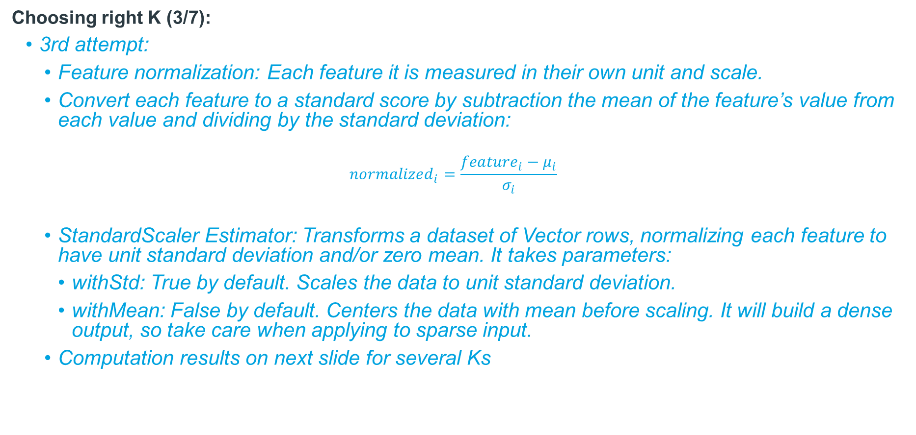
Anomaly Detection
Choosing right K (3/7):
3rd attempt:
Feature normalization: Each feature it is measured in their own unit and scale.
Convert each feature to a standard score by subtraction the mean of the feature’s value from each value and dividing by the standard deviation:
$${normalized}_{i}=\frac{{feature}_{i}−μ_{i}}{σ_{i}}$$
StandardScaler Estimator: Transforms a dataset of Vector rows, normalizing each feature to have unit standard deviation and/or zero mean. It takes parameters:
withStd: True by default. Scales the data to unit standard deviation.
withMean: False by default. Centers the data with mean before scaling. It will build a dense output, so take care when applying to sparse input.
Computation results on next slide for several Ks

Slide 17
Anomaly Detection
Choosing right K (4/7):
Computation results for 3rd attempt (normalization):
val scaler = new StandardScaler()
.setInputCol("featureVector")
.setOutputCol("scaledFeatureVector")
.setWithStd(true)
.setWithMean(false)
[…]
val pipeline = new Pipeline().setStages(Array(assembler, scaler, kmeans))
val pipelineModel = pipeline.fit(data)
[…]
val kmeansModel = pipelineModel.stages.last.asInstanceOf[KMeansModel]
kmeansModel.computeCost(pipelineModel.transform(data)) / data.count() //mean (clustering score)
(100 to 400 by 20)
.map(k => (k, clusteringScore2(data, k))).foreach(println)
(100,0.16770735082146013)
(120,0.14189028066526427)
(140,0.13160877896701986)
(160,0.11705448730963436)
(180,0.10659109526794978)
(200,0.09751485315005425)
(220,0.08890322208092712)
(240,0.0845856215275481)
(260,0.07925154946860839)
(280,0.07581899750693868)
(300,0.07183859995421085)
(320,0.06745382286718403)
(340,0.06509028530888612)
(360,0.062413392682350334)
(380,0.059366645227293825)
(400,0.05779961974009073)

Slide 18
Anomaly Detection
Choosing right K (5/7):
Computation results for 4th attempt (low entropy):
Preservation of hyper params & normalization of previous slides
Substitution of the mean for all the distances to a particular K as clustering score:
//computeCost: Returns the K-means cost (sum of squared distances of points to their nearest center) for this model on the given data.
kmeansModel.computeCost(assembler.transform(data)) / data.count() // mean for a particular K
By the low entropy method as clustering score (steps for each K to test)
Execution of prediction pipeline:
val clusterLabelFull = pipelineModel.transform(data) // dataframe
clusterLabelFull.show(25, truncate=false)
Retention of asignated cluster and label:
+------+--------+------+-------+-------------+---------+---------+-----+-------------------------------------------------------+--------------------------------------------------------------------------------------------------------------------------+-------+ |wk_id |trans_dt|fcc_cd|shop_cd|trans_typ_nbr|trans_qty|trans_amt|label|featureVector |scaledFeatureVector |cluster| +------+--------+------+-------+-------------+---------+---------+-----+-------------------------------------------------------+--------------------------------------------------------------------------------------------------------------------------+-------+ |201701|20170103|453606|2330 |91 |4 |49.44 |1 |[201701.0,2.0170103E7,453606.0,2330.0,91.0,4.0,49.44] |[0.0,8667.669694129014,1.7930672073723162,0.6009112727014525,2.8003393448342098,0.19748238436239035,0.050201470429206925] |42 | |201701|20170105|11443 |5072 |32 |18 |135.9 |1 |[201701.0,2.0170105E7,11443.0,5072.0,32.0,18.0,135.9] |[0.0,8667.670553586171,0.04523323777454755,1.3080781009192133,0.9847347146669749,0.8886707296307566,0.1379931195657205] |9 | |201701|20170104|313961|4169 |31 |2 |22.5 |1 |[201701.0,2.0170104E7,313961.0,4169.0,31.0,2.0,22.5] |[0.0,8667.670123857592,1.2410620086458728,1.0751927450181782,0.953961754833632,0.09874119218119518,0.022846542974457037] |18 |
+-------+-----+ |cluster|label| +-------+-----+ |42 |1 | |9 |1 | |18 |1 | |9 |1 | |21 |1 |

Slide 19
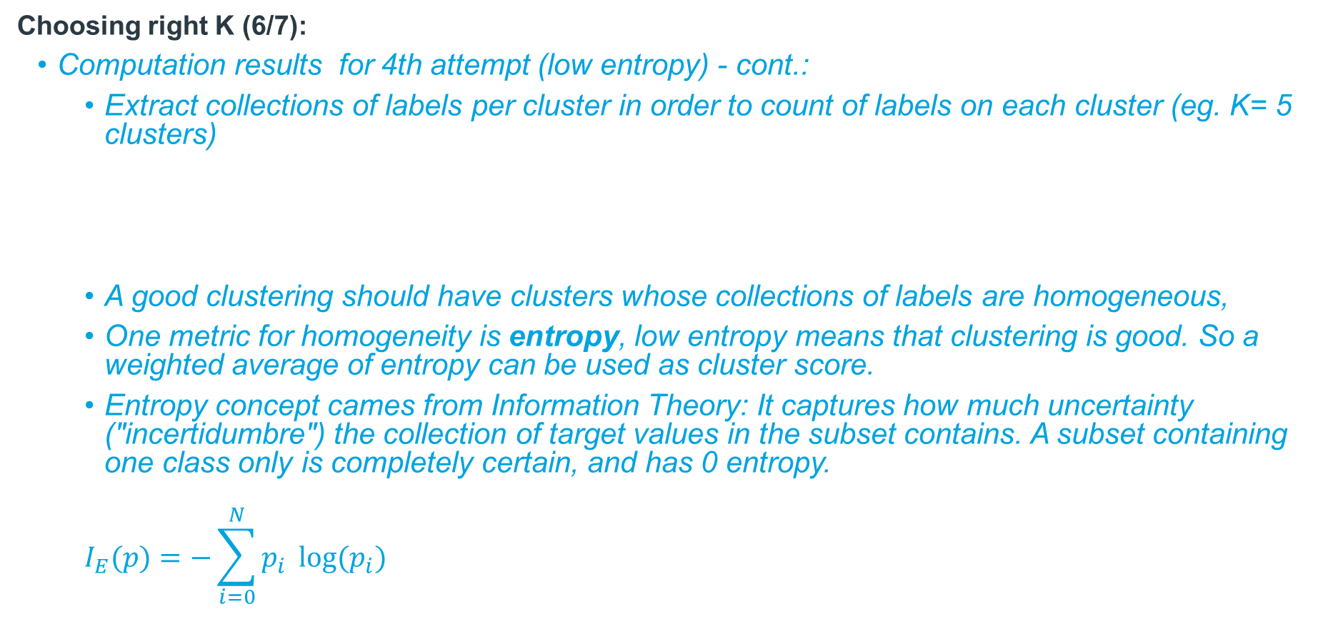
Anomaly Detection
Choosing right K (6/7):
Computation results for 4th attempt (low entropy) - cont.:
Extract collections of labels per cluster in order to count of labels on each cluster (eg. K= 5 clusters)
A good clustering should have clusters whose collections of labels are homogeneous,
One metric for homogeneity is entropy, low entropy means that clustering is good. So a weighted average of entropy can be used as cluster score.
Entropy concept cames from Information Theory: It captures how much uncertainty ("incertidumbre") the collection of target values in the subset contains. A subset containing one class only is completely certain, and has 0 entropy.
$$I_{E}(p)=−\sum_{i=0}^{N}{p_{i}} log⁡(p_{i})$$
label 1 | label 0
7430 | 1
12843
53732 | 5
1
25993 | 4
//for each cluster:
val n = values.map(_.toDouble).sum //values: 7430 | 1 // map the label count in one cluster... val entropy = values.map { v => val p = v / n -p * math.log(p) }.sum //returns a double as entropy for each cluster

Slide 20
Anomaly Detection
Choosing right K (7/7):
Computation results for 4th attempt (low entropy) - cont.
Weighting by cluster size: labels.size * entropy(labelCounts)
Average entropy weighted by cluster size:
// entropy for all the k clusters div by the number of points
weightedClusterEntropy.sum / data.count()
(100 to 400 by 20).map(k => (k, clusteringScore4EntropyCalculus(data, k))).foreach(println)
clusteringScore4EntropyCalculus
(100,2.9603550193587426E-4) (120,2.8556669252159195E-4) (140,2.557831689753919E-4) (160,2.4205132161333814E-4) (180,2.599602872346715E-4) (200,2.505642016926496E-4) (220,2.601822787346768E-4) (240,2.2818569536202385E-4) <- good candidate (260,2.4373480115106713E-4) (280,1.8339071281034587E-4) (300,1.8793613197307901E-4) (320,1.5994217316693247E-4) (340,2.3410672108642986E-4) (360,2.1485261783729033E-4) (380,1.7098063079669802E-4) (400,1.5088534095466805E-4)

Slide 21
Anomaly Detection
Building the anomaly detector (1/2):
Once K is choosen full pipelineModel is run one more time to get:
The centroids of all the clusters
val kMeansModel = pipelineModel.stages.last.asInstanceOf[KMeansModel]
val centroids = kMeansModel.clusterCenters
The predicted cluster for each register:
Then set the user limit: (number of registers taken as anomalies, 100)
Calculate the squared distance from the points to the centroids, sort and take as threshold the distance for the user limit
val clustered = pipelineModel.transform(data) +------+--------+------+-------+-------------+---------+---------+-----+------------------------------------------------------+--------------------------------------------------------------------------------------------------------------------------+-------+ |wk_id |trans_dt|fcc_cd|shop_cd|trans_typ_nbr|trans_qty|trans_amt|label|featureVector |scaledFeatureVector |cluster| +------+--------+------+-------+-------------+---------+---------+-----+------------------------------------------------------+--------------------------------------------------------------------------------------------------------------------------+-------+ |201701|20170103|453606|2330 |91 |4 |49.44 |1 |[201701.0,2.0170103E7,453606.0,2330.0,91.0,4.0,49.44] |[0.0,8667.669694129014,1.7930672073723162,0.6009112727014525,2.8003393448342098,0.19748238436239035,0.050201470429206925] |74 | |201701|20170105|11443 |5072 |32 |18 |135.9 |1 |[201701.0,2.0170105E7,11443.0,5072.0,32.0,18.0,135.9] |[0.0,8667.670553586171,0.04523323777454755,1.3080781009192133,0.9847347146669749,0.8886707296307566,0.1379931195657205] |102 | |201701|20170104|313961|4169 |31 |2 |22.5 |1 |[201701.0,2.0170104E7,313961.0,4169.0,31.0,2.0,22.5] |[0.0,8667.670123857592,1.2410620086458728,1.0751927450181782,0.953961754833632,0.09874119218119518,0.022846542974457037] |181 | |201701|20170105|7631 |5984 |31 |2 |13.0 |1 |[201701.0,2.0170105E7,7631.0,5984.0,31.0,2.0,13.0] |[0.0,8667.670553586171,0.030164715324440473,1.5432845733242453,0.953961754833632,0.09874119218119518,0.013200224829686288]|102 |
50.16104918267672 45.400328707225555 35.79931097577939 22.250799617716584 ... (100 in total) 3.843270196841613 3.766700575359129 <- threshold
val threshold = clustered.
select("cluster", "scaledFeatureVector").as[(Int, Vector)].
map { case (cluster, vec) => Vectors.sqdist(centroids(cluster), vec) }.
orderBy($"value".desc).take(100).last

Slide 22
Anomaly Detection
Building the anomaly detector (2/2):
Filter the records to obtain those whose distance to the centroid exceeds the threshold
Those registers are considered as “Anomalous” and need further investigation:
val originalCols = data.columns val anomalies = clustered.filter { row => val cluster = row.getAs[Int]("cluster") val vec = row.getAs[Vector]("scaledFeatureVector") Vectors.sqdist(centroids(cluster), vec) >= threshold }.select(originalCols.head, originalCols.tail:_*)
/* +------+--------+------+-------+-------------+---------+---------+-----+ | wk_id|trans_dt|fcc_cd|shop_cd|trans_typ_nbr|trans_qty|trans_amt|label| +------+--------+------+-------+-------------+---------+---------+-----+ |201701|20170103|320722| 8336| 31| 2| 5000.98| 0| |201701|20170103|214268| 5204| 11| 2| 32000.9| 0| |201701|20170104|112008| 2710| 21| 2| 8000.26| 0| |201701|20161231| 8715| 7336| 31| 2| 20000.9| 0| |201701|20170104|230765| 4543| 21| 2| 24000.64| 0| |201701|20170104|829011| 2363| 91| 2| 27410.34| 1| |201701|20170103|532337| 2948| 31| 2| 40000.0| 0| |201701|20161231|793279| 4176| 11| 2| 2198.16| 1| */

Slide 23
Anomaly Detection
Categorical Features:
Not the case for this dataset but if some categorical value (non numeric) is included transformation into numeric is needed in order k-means can use it
The categorical features can translate into several binary indicator features using onehot encoding, which can be viewed as numeric dimensions.
For example, let’s supouse the dataset has a categorical feature named “type” with 3 possible values: a, b, c
This feature could be thought of as three features, perhaps is_a, is_b, and is_c.
a type should be translated into 1,0,0
b type should be translated into 0,1,0
c type should be translated into 0,0,1
This translation is usually done using a one-hot encoder
This new, larger data set can be normalized again, and clustered again, perhaps trying larger k as well

Slide 24
Anomaly Detection
Dimesionality reduction:
Not the case for this dataset but sometimes dataset number of features can be very large.

Slide 25
Anomaly Detection
Q&A

